Slide 1
Chapter 4: Wireless LANs
Scaling Networks
Notes:
Cisco Networking Academy program
Scaling Networks
Chapter 4: Wireless LANs

Slide 2
Chapter 4
4.0 Introduction
4.1 Wireless LAN Concepts
4.2 Wireless LAN Operations
4.3 Wireless LAN Security
4.4 Wireless LAN Configuration
4.5 Summary
Notes:
Chapter 4

Slide 3
Chapter 4: Objectives
Describe wireless LAN technology and standards.
Describe the components of a wireless LAN infrastructure.
Describe wireless topologies.
Describe the 802.11 frame structure.
Describe the media contention method used by wireless technology.
Describe channel management in a WLAN.
Describe threats to wireless LANs.
Describe wireless LAN security mechanisms.
Configure a wireless router to support a remote site.
Configure wireless clients to connect to a wireless router.
Troubleshoot common wireless configuration issues.
Notes:
Chapter 4 Objectives

Slide 4
4.1 Wireless Concepts
Notes:
4.1 Wireless Concepts

Slide 5
WLAN Components Supporting Mobility
Productivity is no longer restricted to a fixed work location or a defined time period.
People now expect to be connected at any time and place, from the office to the airport or the home.
Users now expect to be able to roam wirelessly.
Roaming enables a wireless device to maintain Internet access without losing a connection.
Notes:
4.1.1.1 Supporting Mobility

Slide 6
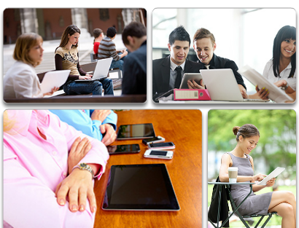
WLAN Components Benefits of Wireless
Increased flexibility
Increased productivity
Reduced costs
Ability to grow and adapt to changing requirements
Notes:
4.1.1.2 Benefits of Wireless

Slide 7
WLAN Components Wireless Technologies
Wireless networks can be classified broadly as:
Wireless personal-area network (WPAN) – Operates in the range of a few feet (Bluetooth).
Wireless LAN (WLAN) – Operates in the range of a few hundred feet.
Wireless wide-area network (WWAN) – Operates in the range of miles.
Bluetooth – An IEEE 802.15 WPAN standard; uses a device-pairing process to communicate over distances up to .05 mile (100m).
Wi-Fi (wireless fidelity) – An IEEE 802.11 WLAN standard; provides network access to home and corporate users, to include data, voice and video traffic, to distances up to 0.18 mile (300m).
Notes:
4.1.1.3 Wireless Technologies

Slide 8
WLAN Components Wireless Technologies (cont.)
Worldwide Interoperability for Microwave Access (WiMAX) – An IEEE 802.16 WWAN standard that provides wireless broadband access of up to 30 mi (50 km).
Cellular broadband – Consists of various corporate, national, and international organizations using service provider cellular access to provide mobile broadband network connectivity.
Satellite Broadband – Provides network access to remote sites through the use of a directional satellite dish.
Notes:
4.1.1.3 Wireless Technologies

Slide 9
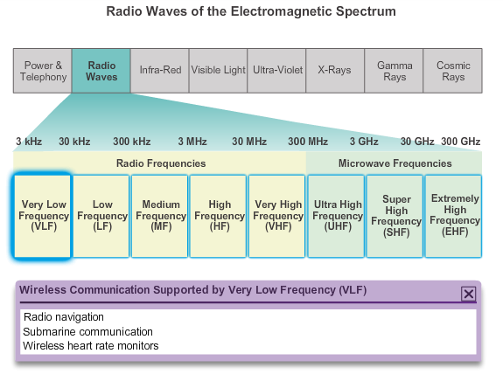
WLAN Components Radio Frequencies
Notes:
4.1.1.4 Radio Frequencies

Slide 10
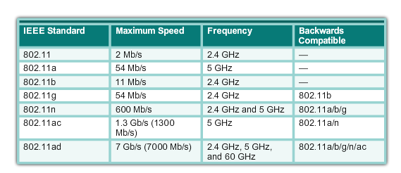
WLAN Components 802.11 Standards
Notes:
4.1.1.5 802.11 Standards

Slide 11
WLAN Components Wi-Fi Certification
The Wi-Fi Alliance certifies Wi-Fi and the following product compatibility:
IEEE 802.11a/b/g/n/ac/ad-compatible.
IEEE 802.11i secure using WPA2™ and Extensible Authentication Protocol (EAP)
Wi-Fi Protected Setup (WPS) to simplify device connections.
Wi-Fi Direct to share media between devices
Wi-Fi Passpoint to simplify securely connecting to Wi-Fi hotspot networks
Wi-Fi Miracast to seamlessly display video between devices
Notes:
4.1.1.6 Wi-Fi Certification

Slide 12
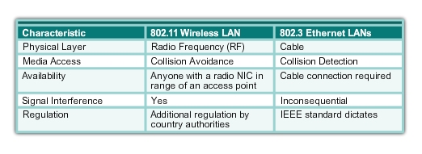
WLAN Components Comparing WLANs to LANs
Notes:
4.1.1.7 Comparing WLANs to LANs

Slide 13
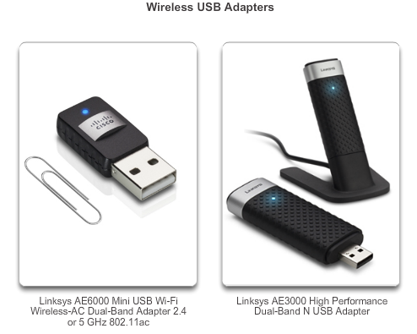
Components of WLANs Wireless NICs
Wireless deployment requires:
End devices with wireless NICs
Infrastructure device, such as a wireless router or wireless AP
Notes:
4.1.2.1 Wireless NICs

Slide 14
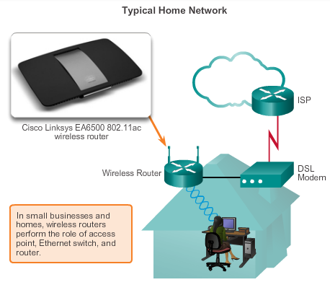
Components of WLANs Wireless Home Router
A home user typically interconnects wireless devices using a small, integrated wireless router.
These serve as:
access point
Ethernet switch
router
Notes:
4.1.2.2 Wireless Home Router

Slide 15
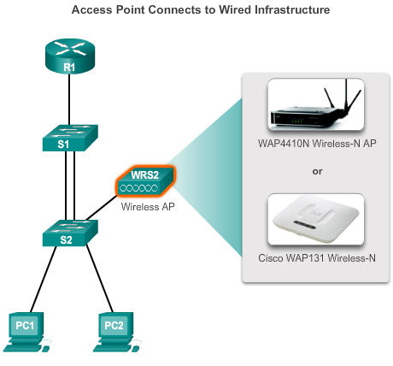
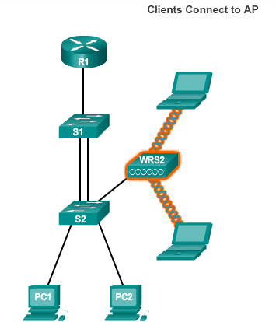
Components of WLANs Business Wireless Solutions
Notes:
4.1.2.3 Business Wireless Solutions

Slide 16
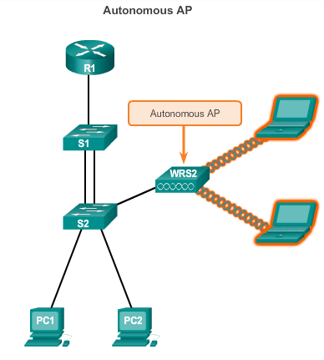
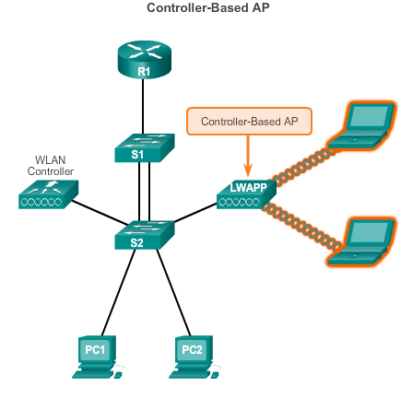
Components of WLANs Wireless Access Points
Notes:
4.1.2.4 Wireless Access Points

Slide 17
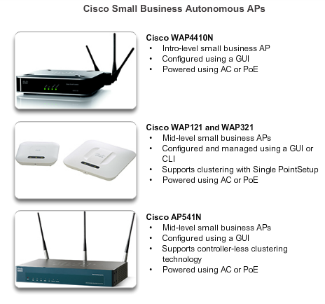
Components of WLANs Small Wireless Deployment Solutions
Notes:
4.1.2.5 Small Wireless Deployment Solutions

Slide 18
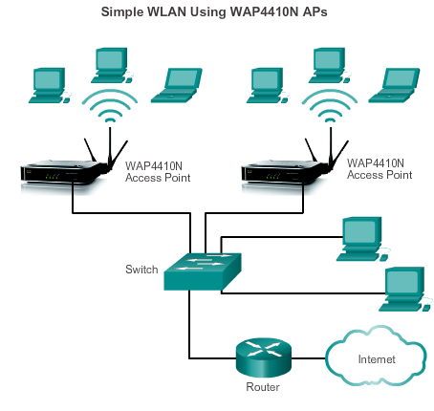
Components of WLANs Small Wireless Deployment Solutions (cont.)
Each AP is configured and managed individually.
This can become a problem when several APs are required.
Notes:
4.1.2.5 Small Wireless Deployment Solutions

Slide 19
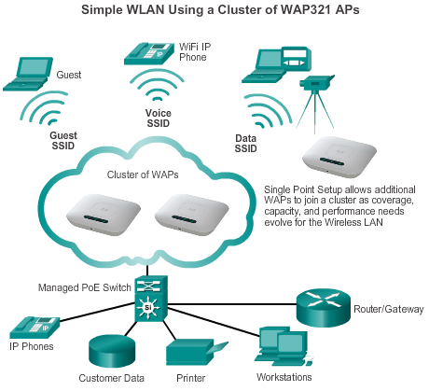
Components of WLANs Small Wireless Deployment Solutions
Support the clustering of APs without the use of a controller.
Multiple APs can be deployed and pushed to a single configuration to all devices within the cluster, managing the wireless network as a single system without worrying about interference between APs, and without configuring each AP as a separate device.
Notes:
4.1.2.5 Small Wireless Deployment Solutions

Slide 20
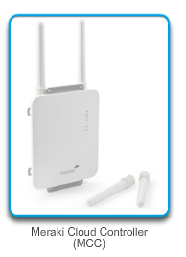
Components of WLANs Large Wireless Deployment Solutions
For larger organizations with many APs, Cisco provides controller-based managed solutions, including the Cisco Meraki Cloud Managed Architecture and the Cisco Unified Wireless Network Architecture.
Cisco Meraki cloud architecture is a management solution used to simplify the wireless deployment. Using this architecture, APs are centrally managed from a controller in the cloud.
Notes:
4.1.2.6 Large Wireless Deployment Solutions

Slide 21
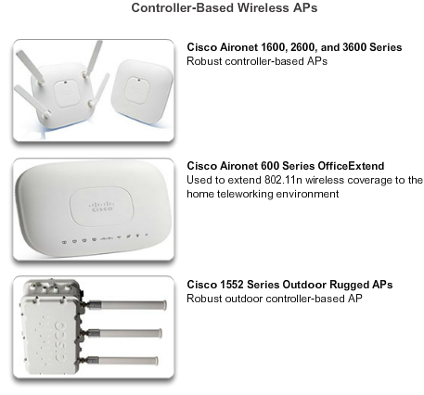
Components of WLANs Large Wireless Deployment Solutions (cont.)
Notes:
4.1.2.7 Large Wireless Deployment Solutions, Cont.

Slide 22
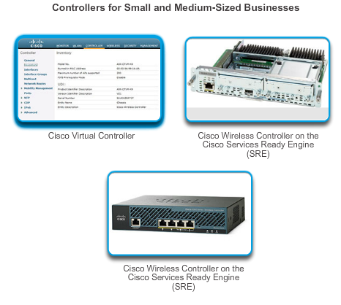
Components of WLANs Large Wireless Deployment Solutions (cont.)
Notes:
4.1.2.7 Large Wireless Deployment Solutions, Cont.

Slide 23
Components of WLANs Wireless Antennas
Cisco Aironet APs can use:
Omnidirectional Wi-Fi Antennas – Factory Wi-Fi gear often uses basic dipole antennas, also referred to as “rubber duck” design, similar to those used on walkie-talkie radios. Omnidirectional antennas provide 360-degree coverage.
Directional Wi-Fi Antennas – Directional antennas focus the radio signal in a given direction, which enhances the signal to and from the AP in the direction the antenna is pointing.
Yagi antennas – Type of directional radio antenna that can be used for long-distance Wi-Fi networking.
Notes:
4.1.2.8 Wireless Antennas

Slide 24
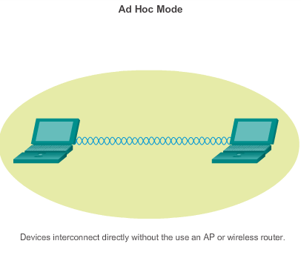
802.11 WLAN Topologies 802.11 Wireless Topology Modes
Notes:
4.1.3.1 802.11 Wireless Topology Modes

Slide 25
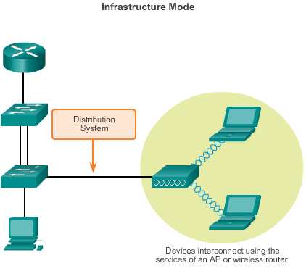
802.11 WLAN Topologies 802.11 Wireless Topology Modes (cont.)
Notes:
4.1.3.1 802.11 Wireless Topology Modes

Slide 26
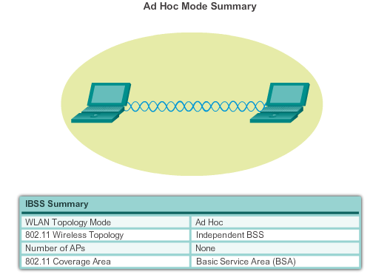
802.11 WLAN Topologies Ad Hoc Mode
Tethering (personal hotspot) – Variation of the Ad Hoc topology when a smart phone or tablet with cellular data access is enabled to create a personal hotspot.
Notes:
4.1.3.2 Ad Hoc Mode

Slide 27
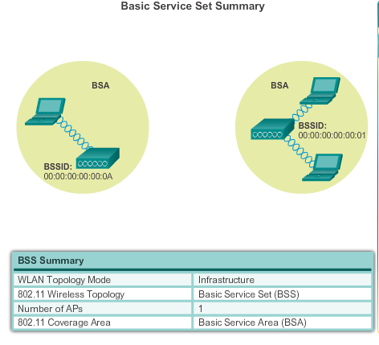
802.11 WLAN Topologies Infrastructure Mode
Notes:
4.1.3.3 Infrastructure Mode

Slide 28
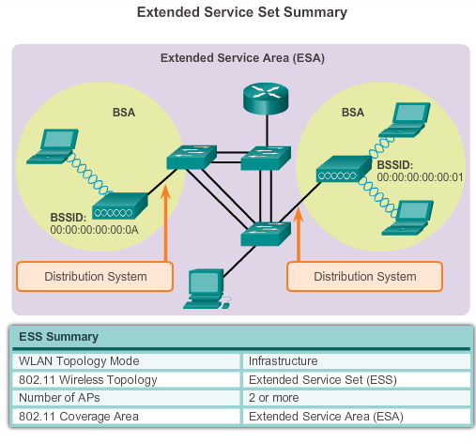
802.11 WLAN Topologies Infrastructure Mode (cont.)
Notes:
4.1.3.3 Infrastructure Mode

Slide 29
4.2 Wireless LAN Operations
Notes:
4.2 Wireless LAN Operations

Slide 30
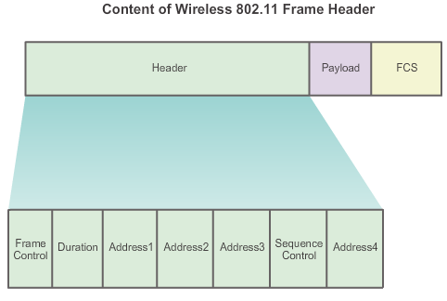
802.11 Frame Structure Wireless 802.11 Frame
Notes:
4.2.1.1 Wireless 802.11 Frame

Slide 31
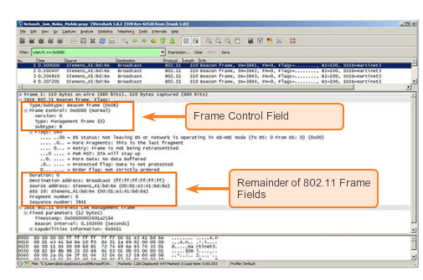
802.11 Frame Structure Wireless 802.11 Frame
Notes:
4.2.1.1 Wireless 802.11 Frame

Slide 32
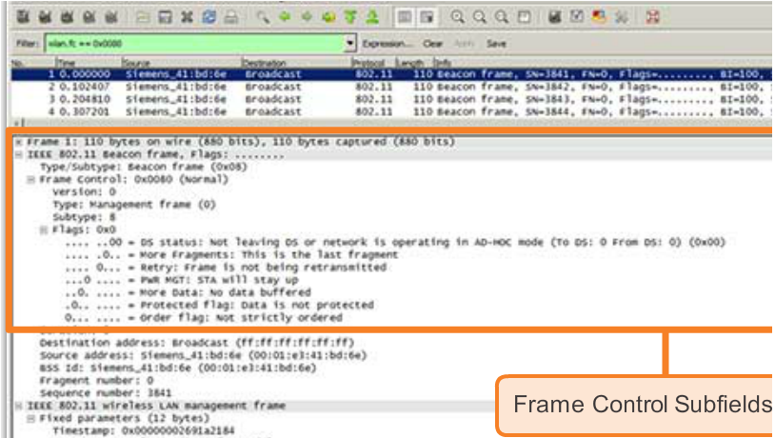
802.11 Frame Structure Frame Control Field
Notes:
4.2.1.2 Frame Control Field

Slide 33
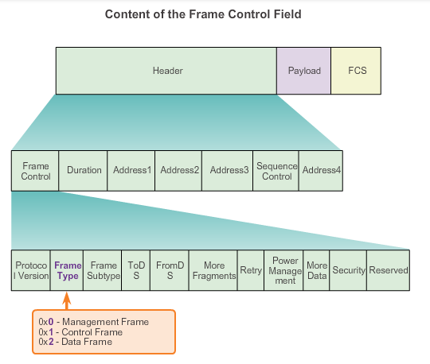
802.11 Frame Structure Wireless Frame Type
Notes:
4.2.1.3 Wireless Frame Type

Slide 34
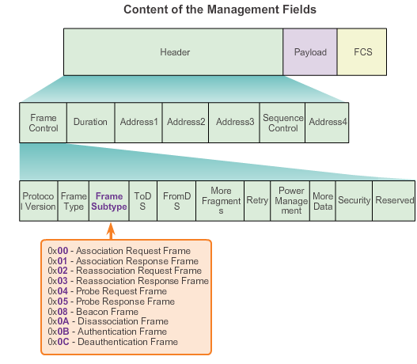
802.11 Frame Structure Management Frames
Notes:
4.2.1.4 Management Frames

Slide 35
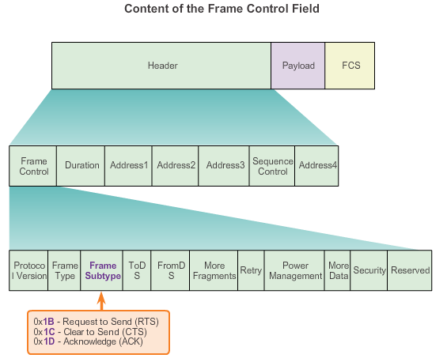
802.11 Frame Structure Control Frames
Notes:
4.2.1.5 Control Frames

Slide 36
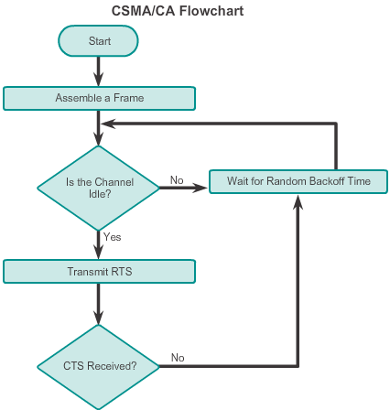
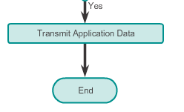
Wireless Operation CSMA/CA
CSMA/CA Flowchart
Notes:
4.2.2.1 CSMA/CA

Slide 37
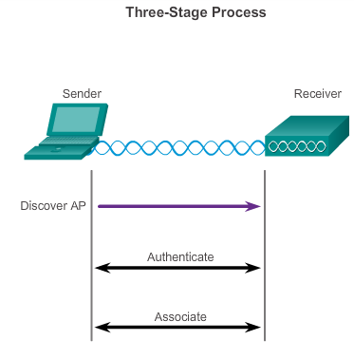
Wireless Operation Wireless Clients and Access Point Association
Notes:
4.2.2.2 Wireless Clients and Access Point Association

Slide 38
Wireless Operation Association Parameters
SSID – Unique identifier that wireless clients use to distinguish between multiple wireless networks in the same vicinity.
Password – Required from the wireless client to authenticate to the AP. Sometimes called the security key.
Network mode – Refers to the 802.11a/b/g/n/ac/ad WLAN standards. APs and wireless routers can operate in a mixed mode; i.e., it can simultaneously use multiple standards.
Security mode – Refers to the security parameter settings, such as WEP, WPA, or WPA2.
Channel settings – Refers to the frequency bands used to transmit wireless data. Wireless routers and AP can choose the channel setting or it can be manually set.
Notes:
4.2.2.3 Association Parameters

Slide 39
Wireless Operation Discovering APs
Passive mode
AP advertises its service by sending broadcast beacon frames containing the SSID, supported standards, and security settings.
The beacon’s primary purpose is to allow wireless clients to learn which networks and APs are available in a given area.
Active mode
Wireless clients must know the name of the SSID.
Wireless client initiates the process by broadcasting a probe request frame on multiple channels.
Probe request includes the SSID name and standards supported.
May be required if an AP or wireless router is configured to not broadcast beacon frames.
Notes:
4.2.2.4 Discovering APs

Slide 40
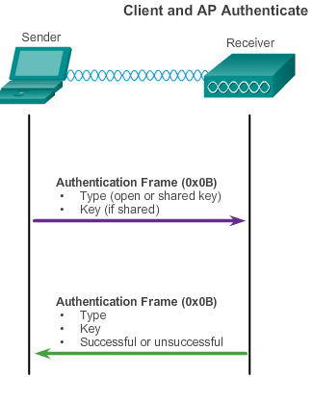
Wireless Operation Authentication
Open authentication – A NULL authentication where the wireless client says “authenticate me” and the AP responds with “yes.” Used where security is of no concern.
Shared key authentication – Technique is based on a key that is pre-shared between the client and the AP.
Notes:
4.2.2.5 Authentication

Slide 41
Channel Management Frequency Channel Saturation
Direct-sequence spread spectrum (DSSS)
Uses spread-spectrum modulation technique; designed to spread a signal over a larger frequency band making it more resistant to interference.
Used by 802.11b.
Frequency-hopping spread spectrum (FHSS)
Relies on spread-spectrum methods to communicate.
Transmits radio signals by rapidly switching a carrier signal among many frequency channels.
This channel-hopping process allows for a more efficient usage of the channels, decreasing channel congestion.
Used by the original 802.11 standard.
Notes:
4.2.3.1 Frequency Channel Saturation

Slide 42
Channel Management Frequency Channel Saturation (cont.)
Orthogonal Frequency-Division Multiplexing (OFDM)
Subset of frequency division multiplexing in which a single channel utilizes multiple subchannels on adjacent frequencies.
Because OFDM uses subchannels, channel usage is very efficient.
Used by a number of communication systems, including 802.11a/g/n/ac.
Notes:
4.2.3.1 Frequency Channel Saturation (continued)

Slide 43
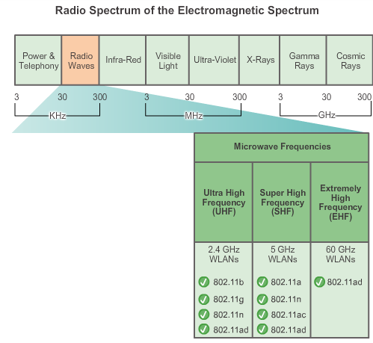
Channel Management Selecting Channels
Notes:
4.2.3.2 Selecting Channels

Slide 44
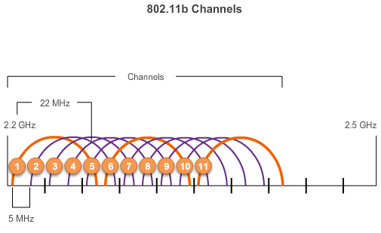
Channel Management Selecting Channels (cont.)
The solution to 802.11b interference is to use nonoverlapping channels 1, 6, and 11.
Notes:
4.2.3.2 Selecting Channels

Slide 45
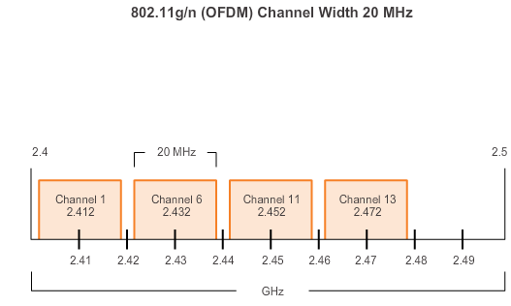
Channel Management Selecting Channels (cont.)
Use channels in the larger, less-crowded 5 GHz band, reducing “accidental denial of service (DoS),” this band can support four non-overlapping channels.
Notes:
4.2.3.2 Selecting Channels

Slide 46
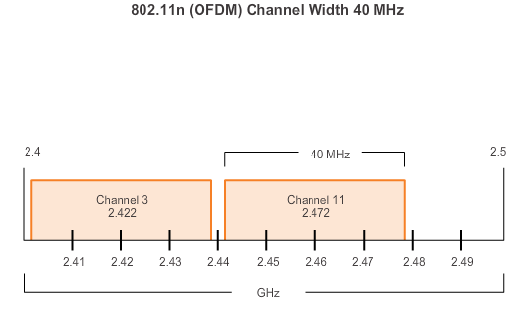
Channel Management Selecting Channels (cont.)
Channel bonding combines two 20-MHz channels into one 40-MHz channel.
Notes:
4.2.3.2 Selecting Channels

Slide 47
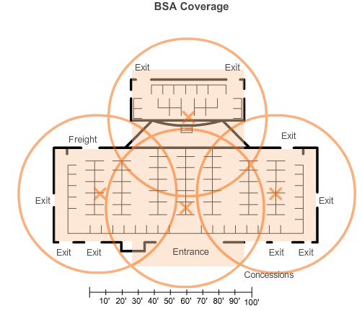
Channel Management Planning a WLAN Deployment
If APs are to use existing wiring, or if there are locations where APs cannot be placed, note these locations on the map.
Position APs above obstructions.
Position APs vertically near the ceiling in the center of each coverage area, if possible.
Position APs in locations where users are expected to be.
Notes:
4.2.3.3 Planning a WLAN Deployment

Slide 48
4.3 Wireless LAN Security
Notes:
4.3 Wireless LAN Security

Slide 49
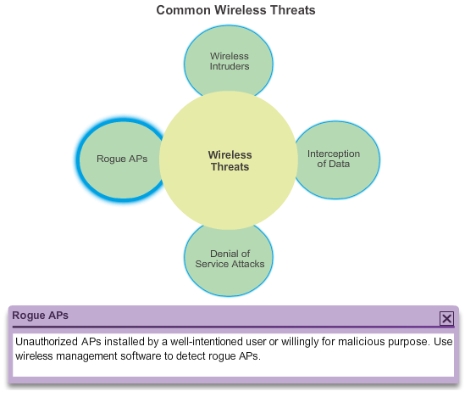
WLAN Threats Securing Wireless
Notes:
4.3.1.1 Securing Wireless

Slide 50
WLAN Threats DoS Attack
Wireless DoS attacks can be the result of:
Improperly configured devices.
Configuration errors can disable the WLAN.
A malicious user intentionally interfering with the wireless communication. Disable the wireless network where no legitimate device can access the medium.
Accidental interference
WLANs operate in the unlicensed frequency bands and are prone to interference from other wireless devices.
May occur from such devices as microwave ovens, cordless phones, baby monitors, and more.
2.4 GHz band is more prone to interference than the 5 GHz band.
Notes:
4.3.1.2 DoS Attack

Slide 51
WLAN Threats Management Frame DoS Attacks
A spoofed disconnect attack
Occurs when an attacker sends a series of “disassociate” commands to all wireless clients.
Cause all clients to disconnect.
The wireless clients immediately try to re-associate, which creates a burst of traffic.
A CTS flood
An attacker takes advantage of the CSMA/CA contention method to monopolize the bandwidth.
The attacker repeatedly floods Clear to Send (CTS) frames to a bogus STA.
All wireless clients sharing the RF medium receive the CTS and withhold transmissions until the attacker stops transmitting the CTS frames.
Notes:
4.3.1.3 Management Frame Dos Attacks

Slide 52
WLAN Threats Rogue Access Points
A rogue AP is an AP or wireless router that has been:
Connected to a corporate network without explicit authorization and against corporate policy.
Connected or enabled by an attacker to capture client data, such as the MAC addresses of clients (both wireless and wired), or to capture and disguise data packets, to gain access to network resources, or to launch man-in-the-middle (MITM) attacks.
To prevent the installation of rogue APs, organizations must use monitoring software to actively monitor the radio spectrum for unauthorized APs.
Notes:
4.3.1.4 Rogue Access Points

Slide 53
WLAN Threats Man-in-the-Middle Attack
“Evil twin AP” attack:
A popular wireless MITM attack where an attacker introduces a rogue AP and configures it with the same SSID as a legitimate AP.
Locations offering free Wi-Fi, such as airports, cafes, and restaurants, are hotbeds for this type of attack due to the open authentication.
Connecting wireless clients would see two APs offering wireless access. Those near the rogue AP find the stronger signal and most likely associate with the evil twin AP. User traffic is now sent to the rogue AP, which in turn captures the data and forwards it to the legitimate AP.
Return traffic from the legitimate AP is sent to the rogue AP, captured, and then forwarded to the unsuspecting STA.
Notes:
4.3.1.4 Man-in-the-Middle Attack

Slide 54
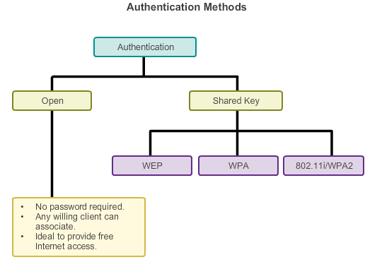
Securing WLANs Wireless Security Overview
Use authentication and encryption to secure a wireless network.
Notes:
4.3.2.1 Wireless Security Overview

Slide 55
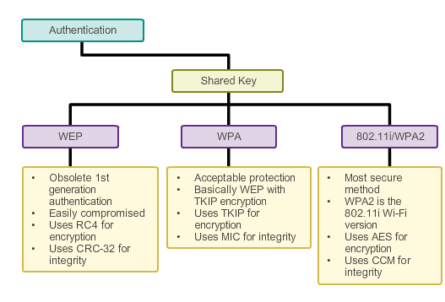
Securing WLANs Shared Key Authentication Methods
Notes:
4.3.2.2 Shared Key Authentication Methods

Slide 56
Securing WLANs Encryption Methods
IEEE 802.11i and the Wi-Fi Alliance WPA and WPA2 standards use the following encryption protocols:
Temporal Key Integrity Protocol (TKIP)
Used by WPA.
Makes use of WEP, but encrypts the Layer 2 payload using TKIP, and carries out a Cisco Message Integrity Check (MIC).
Advanced Encryption Standard (AES)
Encryption method used by WPA2.
Preferred method because it aligns with the industry standard IEEE 802.11iA.
Stronger method of encryption.
Uses the Counter Cipher Mode with Block Chaining Message Authentication Code Protocol (CCMP).
Always choose WPA2 with AES when possible.
Notes:
4.3.2.3 Encryption Methods

Slide 57
Securing WLANs Authenticating a Home User
WPA and WPA2 support two types of authentication:
Personal
Intended for home or small office networks, or authenticated users who use a pre-shared key (PSK).
No special authentication server is required.
Enterprise
Requires a Remote Authentication Dial-In User Service (RADIUS) authentication server.
Provides additional security.
Users must authenticate using 802.1X standard, which uses the Extensible Authentication Protocol (EAP) for authentication.
Notes:
4.3.2.4 Authenticating a Home User

Slide 58
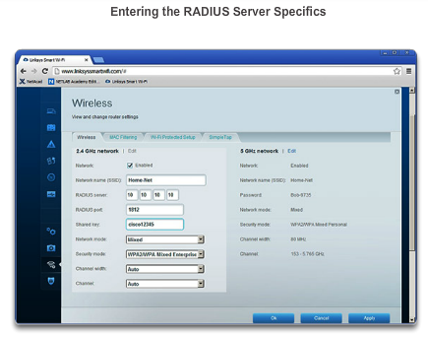
Securing WLANs Authentication in the Enterprise
Enterprise security mode choices require an Authentication, Authorization, and Accounting (AAA) RADIUS server.
.
Notes:
4.3.2.5 Authentication in the Enterprise

Slide 59
8.4 Wireless LAN Configuration
Notes:
4.4. Wireless LAN Configuration

Slide 60
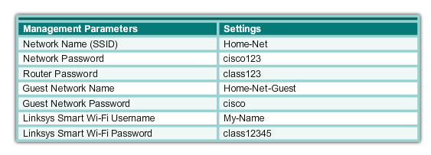
Configure a Wireless Router Configuring a Wireless Router
Before installing a wireless router, consider the following settings:
Notes:
4.4.1.1 Configuring a Wireless Router

Slide 61
Configure a Wireless Router Configuring a Wireless Router
An Implementation Plan consists of the following steps:
Step 1. Start the WLAN implementation process with a single AP and a single wireless client, without enabling wireless security.
Step 2. Verify that the client has received a DHCP IP address and can ping the local, wired default router, and then browse to the external Internet.
Step 3. Configure wireless security using WPA2/WPA Mixed Personal. Never use WEP unless no other options exist.
Step 4. Back up the configuration.
Notes:
4.4.1.1 Configuring a Wireless Router

Slide 62
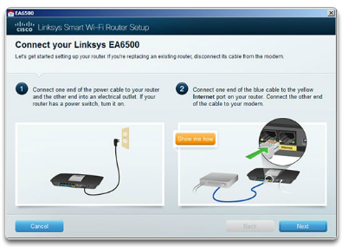
Configure a Wireless Router Set Up and Install the Linksys EAS6500
.
Notes:
4.4.1.2 Set Up and Install Linksys EAS6500

Slide 63
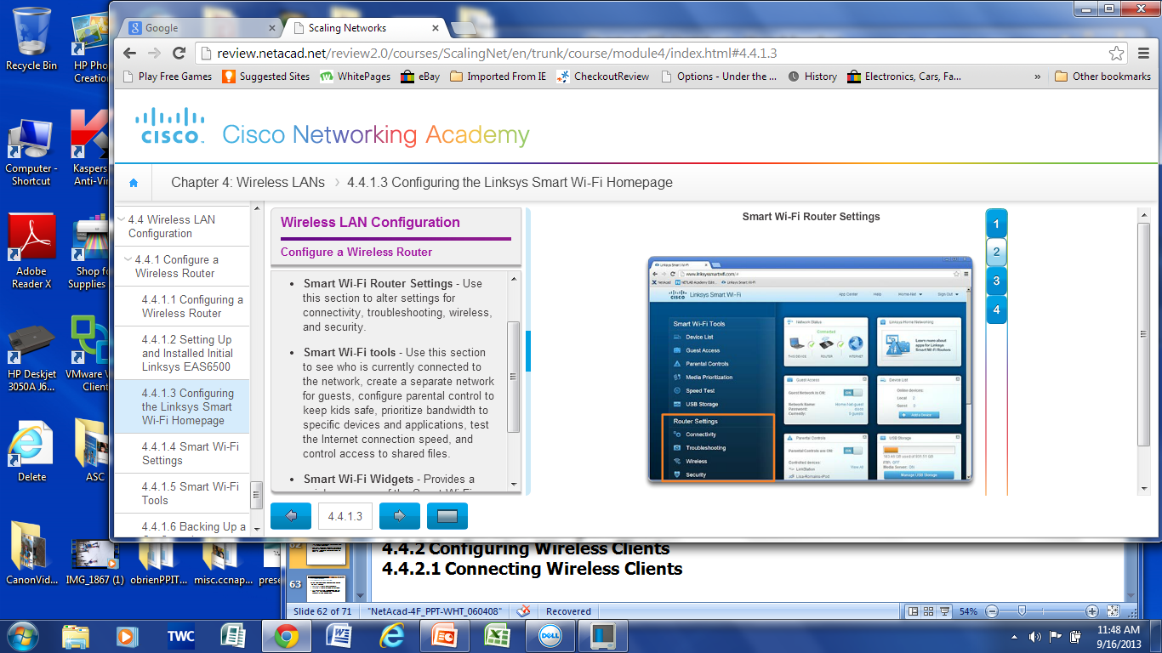
Configure a Wireless Router Configuring a Linksys Smart Wi-Fi Homepage
Notes:
4.4.1.3 Configuring the Linksys Smart Wi-Fi Homepage

Slide 64
Configure a Wireless Router Smart Wi-Fi Settings
Smart Wi-Fi settings enable you to:
Configure the router’s basic settings for the local network.
Diagnose and troubleshoot connectivity issues on the network.
Secure and personalize the wireless network.
Configure the DMZ feature, view connected computers and devices on the network, and set up port forwarding.
Notes:
4.4.1.4 Smart Wi-Fi Settings

Slide 65
Configure a Wireless Router Smart Wi-Fi Tools
Device List – Lists who is connected to the WLAN. Personalize device names and icons. Connect devices.
Guest Access – Creates a separate network for up to 50 guests at home while keeping network files safe with the Guest Access Tool.
Parental Controls – Protects kids and family members by restricting access to potentially harmful websites
Media Prioritization – Prioritizes bandwidth to specific devices and applications.
Speed Test – Tests the upload and download speed of the Internet link. Useful for baselining.
USB Storage – Controls access to shared files.
Notes:
4.4.1.5 Smart Wi-Fi Tools

Slide 66
Configure a Wireless Router Backing Up a Configuration
To back up the configuration with the Linksys EA6500 wireless router, perform the following steps:
Step 1. Log in to the Smart Wi-Fi Home page. Click the Troubleshooting icon to display the Troubleshooting Status window.
Step 2. Click the Diagnostic tab to open the Diagnostic Troubleshooting window.
Step 3. Under the Router configuration title, click Backup and save the file to an appropriate folder.
Notes:
4.4.1.6 Backing Up a Configuration

Slide 67
Configuring Wireless Clients Connecting Wireless Clients
After the AP or wireless router has been configured, the wireless NIC on the client must be altered to allow it to connect to the WLAN.
The user should verify that the client has successfully connected to the correct wireless network, because there may be many WLANs available with which to connect.
Notes:
4.4.2.1 Connecting Wireless Clients

Slide 68
Troubleshoot WLAN Issues Troubleshooting Approaches
Three main troubleshooting approaches used to resolve network problems:
Bottom-up – Start at Layer 1 and work up.
Top-down – Start at the top layer and work down.
Divide-and-conquer – Ping the destination. If the pings fail, verify the lower layers. If the pings are successful, verify the upper layers.
Notes:
4.4.3.1 Troubleshooting Approaches

Slide 69
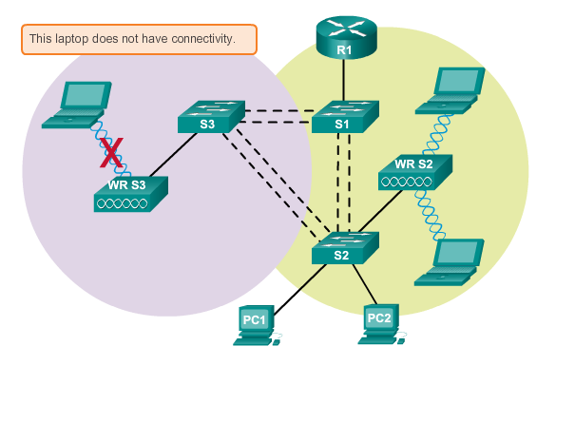
Troubleshoot WLAN Issues Wireless Client Not Connecting
Notes:
4.4.3.2 Wireless Client Not Connecting

Slide 70
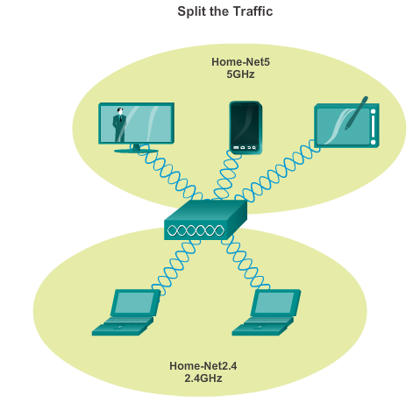
Troubleshoot WLAN Issues Troubleshooting When the Network Is Slow
Notes:
4.4.3.3 Troubleshooting When the Network is Slow

Slide 71
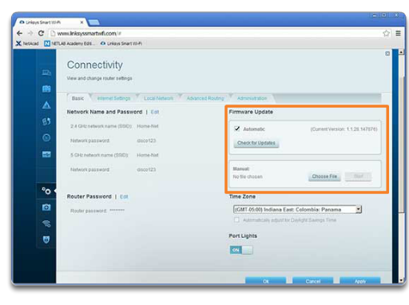
Troubleshoot WLAN Issues Updating Firmware
Notes:
4.4.3.4 Updating Firmware

Slide 72
Chapter 4: Summary
WLANs are often implemented in homes, offices, and campus environments.
Only the 2.4, GHz, 5.0 GHz, and 60 GHz frequencies are used for 802.11 WLANs.
The ITU-R regulates the allocation of the RF spectrum, while IEEE provides the 802.11 standards to define how these frequencies are used for the physical and MAC sub-layer of wireless networks.
The Wi-Fi Alliance certifies that vendor products conform to industry standards and norms.
A STA uses a wireless NIC to connect to an infrastructure device such as a wireless router or wireless AP.
STAs connect using an SSID.
APs can be implemented as standalone devices, in small clusters, or in a larger controller-based network.
Notes:
Chapter 4 Summary

Slide 73
Chapter 4: Summary (cont.)
A Cisco Aironet AP can use an onmidirectional antenna, a directional antenna, or a yagi antenna to direct signals.
IEEE 802.11n/ac/ad use MIMO technology to improve throughput and support up to four antennas, simultaneously.
In ad-hoc mode or IBSS, two wireless devices connect to each other in a P2P manner.
In infrastructure mode, APs connect to network infrastructure using the wired DS.
Each AP defines a BSS and is uniquely identified by its BSSID.
Multiple BSSs can be joined into an ESS.
Using a particular SSID in an ESS provides seamless roaming capabilities among the BSSs in the ESS.
Notes:
Chapter 4 Summary

Slide 74
Chapter 4: Summary (cont.)
Additional SSIDs can be used to segregate the level of network access defined by which SSID is in use.
An STA first authenticates with an AP, and then associates with that AP.
The 802.11i/WPA2 authentication standard should be used. Use the AES encryption method with WPA2.
When planning a wireless network, nonoverlapping channels should be used when deploying multiple APs to cover a particular area. There should be a 10–15 percent overlap between BSAs in an ESS.
Cisco APs support PoE to simplify installation.
Wireless networks are specifically susceptible to threats such as wireless intruders, rogue APs, data interception, and DoS attacks. Cisco has developed a range of solutions to mitigate against these types of threats.
Notes:
Chapter 4 Summary

Slide 75


